Slide 1
Language Models
Formal grammars (e.g. regular, context free) give a hard “binary” model of the legal sentences in a language.
For NLP, a probabilistic model of a language that gives a probability that a string is a member of a language is more useful.
To specify a correct probability distribution, the probability of all sentences in a language must sum to 1.

Slide 2
Uses of Language Models
Speech recognition
  “I ate a cherry” is a more likely sentence than “Eye eight uh Jerry”
OCR & Handwriting recognition
  More probable sentences are more likely correct readings.
Machine translation
  More likely sentences are probably better translations.
Generation
  More likely sentences are probably better NL generations.
Context sensitive spelling correction
  “Their are problems wit this sentence.”

Slide 3
Completion Prediction
A language model also supports predicting the completion of a sentence.
  Please turn off your cell _____
  Your program does not ______
Predictive text input systems can guess what you are typing and give choices on how to complete it.

Slide 4
N-Gram Models
Estimate probability of each word given prior context.
  P(phone | Please turn off your cell)
Number of parameters required grows exponentially with the number of words of prior context.
An N-gram model uses only N−1 words of prior context.
  Unigram: P(phone)
  Bigram: P(phone | cell)
  Trigram: P(phone | your cell)
The Markov assumption is the presumption that the future behavior of a dynamical system only depends on its recent history. In particular, in a kth-order Markov model, the next state only depends on the k most recent states, therefore an N-gram model is a (N−1)-order Markov model.

Slide 5
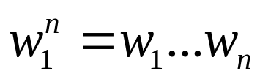
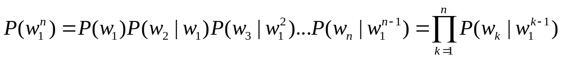
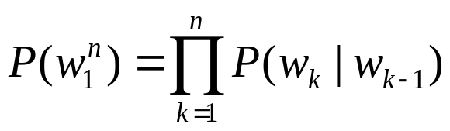
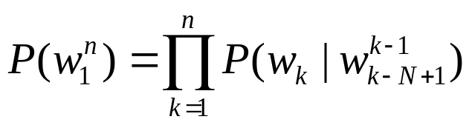
N-Gram Model Formulas
Word sequences
Chain rule of probability
Bigram approximation
N-gram approximation

Slide 6
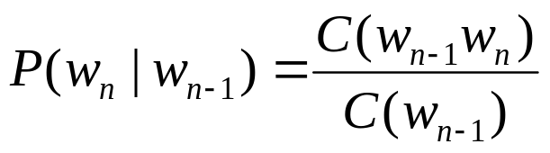
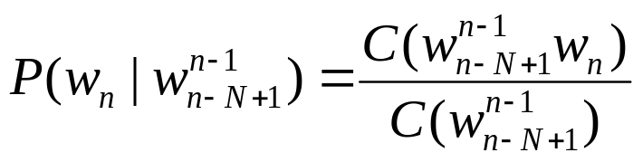
Estimating Probabilities
N-gram conditional probabilities can be estimated from raw text based on the relative frequency of word sequences.
To have a consistent probabilistic model, append a unique start (<s>) and end (</s>) symbol to every sentence and treat these as additional words.
Bigram:
N-gram:

Slide 7
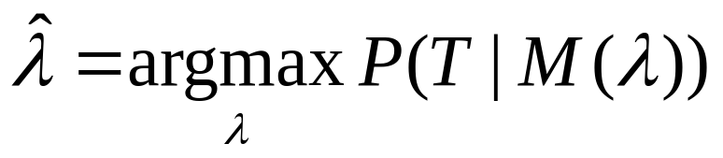
Generative Model & MLE
An N-gram model can be seen as a probabilistic automata for generating sentences.
Relative frequency estimates can be proven to be maximum likelihood estimates (MLE) since they maximize the probability that the model M will generate the training corpus T.
Initialize sentence with N−1 <s> symbols
Until </s> is generated do:
Stochastically pick the next word based on the conditional
probability of each word given the previous N −1 words.

Slide 8
Example from Textbook
P(<s> i want english food </s>)
= P(i | <s>) P(want | i) P(english | want)
P(food | english) P(</s> | food)
= .25 x .33 x .0011 x .5 x .68 = .000031
P(<s> i want chinese food </s>)
= P(i | <s>) P(want | i) P(chinese | want)
P(food | chinese) P(</s> | food)
= .25 x .33 x .0065 x .52 x .68 = .00019

Slide 9
The Chain Rule applied to compute joint probability of words in sentence
P(w₁w₂…w_{n} ) = ∏P(w_{i} | w₁w₂…w_{i−1})
i
P(“its water is so transparent”) =
P(its) × P(water|its) × P(is|its water)
× P(so|its water is) × P(transparent|its water is so)

Slide 10
How to estimate these probabilities
Could we just count and divide?
P(the | its water is so transparent that) =Count(its water is so transparent that the)
Count(its water is so transparent that)
No! Too many possible sentences!
We’ll never see enough data for estimating these

Slide 11
GIVEN CORPUS(TRAINING CORPUS ):
<S> I AM SAM </S>
<S> SAM I AM </S>
<S>I DO NOT LIKE GREEN VEG </S>
BIGRAM PROBABILITY ESTIMATES:
P(I|<S>)=2/3=0.67
P(SAM|<S>)=1/3=0.33
P(AM|I)=2/3=0.67
P(</S>|SAM)=1/2=.50
P(SAM|AM)=?
P(DO|I)=?

Slide 12
Train and Test Corpora
A language model must be trained on a large corpus of text to estimate good parameter values.
Model can be evaluated based on its ability to predict a high probability for a disjoint (held-out) test corpus (testing on the training corpus would give an optimistically biased estimate).
Ideally, the training (and test) corpus should be representative of the actual application data.
May need to adapt a general model to a small amount of new (in-domain) data by adding highly weighted small corpus to original training data.

Slide 13
Evaluation of Language Models
Ideally, evaluate use of model in end application (extrinsic)
  Realistic
  Expensive
Evaluate on ability to model test corpus (intrinsic).
  Less realistic
  Cheaper
Verify at least once that intrinsic evaluation correlates with an extrinsic one.

Slide 14
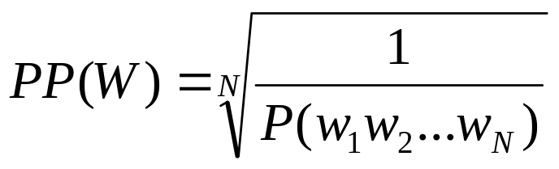
Perplexity
Measure of how well a model “fits” the test data.
Uses the probability that the model assigns to the test corpus.
Normalizes for the number of words in the test corpus and takes the inverse.
Measures the weighted average branching factor in predicting the next word (lower is better).

Slide 15
Sample Perplexity Evaluation
The branching factor of a language is the number of possible next words that can follow any word. Consider the task of recognizing the digits in English (zero, one, two,..., nine), given that each of the 10 digits occurs with equal probability P = 1/ 10 . The perplexity of this mini-language is in fact 10.
PP(W) = P(w1w2 ...wN) ^{− 1/ N}
= ( (1 /10) ^{N} ) ^{− 1/ N} = 10

Slide 16
Smoothing
Since there are a combinatorial number of possible word sequences, many rare (but not impossible) combinations never occur in training, so MLE incorrectly assigns zero to many parameters (a.k.a. sparse data).
If a new combination occurs during testing, it is given a probability of zero and the entire sequence gets a probability of zero (i.e. infinite perplexity).
In practice, parameters are smoothed (a.k.a. regularized) to reassign some probability mass to unseen events.
  Adding probability mass to unseen events requires removing it from seen ones (discounting) in order to maintain a joint distribution that sums to 1.

Slide 17
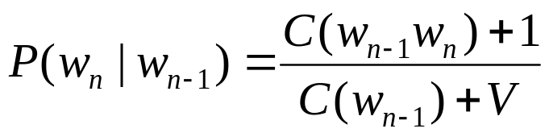
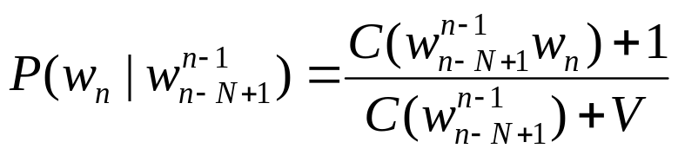
Laplace (Add-One) Smoothing
“Hallucinate” additional training data in which each possible N-gram occurs exactly once and adjust estimates accordingly.
where V is the total number of possible (N−1)-grams (i.e. the vocabulary size for a bigram model).
Bigram:
N-gram:
Tends to reassign too much mass to unseen events, so can be adjusted to add 0<δ<1 (normalized by δV instead of V).

Slide 18
Advanced Smoothing
Many advanced techniques have been developed to improve smoothing for language models.
  Good-Turing
  Interpolation
  Backoff
  Kneser-Ney
  Class-based (cluster) N-grams

Slide 19
A Problem for N-Grams:
Long Distance Dependencies
Many times local context does not provide the most useful predictive clues, which instead are provided by long-distance dependencies.
  Syntactic dependencies
    “The man next to the large oak tree near the grocery store on the corner is tall.”
    “The men next to the large oak tree near the grocery store on the corner are tall.”
  Semantic dependencies
    “The bird next to the large oak tree near the grocery store on the corner flies rapidly.”
    “The man next to the large oak tree near the grocery store on the corner talks rapidly.”
More complex models of language are needed to handle such dependencies.

Slide 20
Summary
Language models assign a probability that a sentence is a legal string in a language.
They are useful as a component of many NLP systems, such as ASR, OCR, and MT.
Simple N-gram models are easy to train on unsupervised corpora and can provide useful estimates of sentence likelihood.
MLE gives inaccurate parameters for models trained on sparse data.
Smoothing techniques adjust parameter estimates to account for unseen (but not impossible) events.

Slide 21
Syntactic Parsing
Syntax: the way words are arranged together
Main ideas of syntax:
  Constituency
    Groups of words may behave as a single unit or phrase, called constituent.
    CFG, a formalism allowing us to model the constituency facts.
  Grammatical relations
    A formalization of ideas from traditional grammar about SUBJECT and OBJECT
  Subcategorization and dependencies
    Referring to certain kind of relations between words and phrases, e.g., the verb want can be followed by an infinite, as in I want to fly to Detroit.
Context Free Grammar for English

Slide 22
Background
All of the kinds of syntactic knowledge can be modeled by various kinds of CFG-based grammars.
CFGs are thus backbone of many models of the syntax of NL.
  Being integral to most models of NLU, of grammar checking, and more recently speech understanding
They are powerful enough to express sophisticated relations among the words in a sentence, yet computationally tractable enough that efficient algorithms exists for parsing sentences with them.
Also probability version of CFG.
Context Free Grammar for English

Slide 23
9.1 Constituency
NP:
  A sequence of words surrounding at least one noun, e.g.,
    three parties from Brooklyn arrive
    a high-class spot such as Mindy’s attracts
    the Broadway coppers love
    They sit
    Harry the Horse
    the reason he comes into the Hot Box
Evidences of constituency
  The above NPs can all appear in similar syntactic environment, e.g., before, a verb.
  Preposed or postposed constructions, e.g., the PP, on September seventeenth, can be placed in a number of different locations
    On September seventeenth, I’d like to fly from Atlanta to Denver.
    I’d like to fly on September seventeenth from Atlanta to Denver.
    I’d like to fly from Atlanta to Denver On September seventeenth.
Context Free Grammar for English

Slide 24
9.2 Context-Free Rules and Trees
CFG (or Phrase-Structure Grammar):
  The most commonly used mathematical system for modeling constituent structure in English and other NLs
  Terminals and non-terminals
  Derivation
  Parse tree
  Start symbol
NP
Det
Nom
Noun
a
flight
Context Free Grammar for English

Slide 25
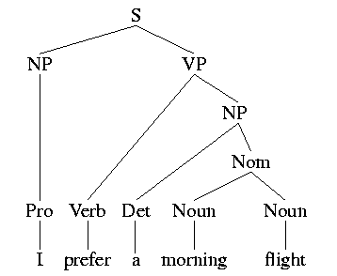
9.2 Context-Free Rules and Trees
Noun → flight | breeze | trip | morning | …
Verb → is | prefer | like | need | want | fly …
Adjective → cheapest | non-stop | first | latest | other | direct | …
Pronoun → me | I | you | it | …
Proper-Noun → Alaska | Baltimore | Los Angeles | Chicago | United | American | …
Determiner → the | a | an | this | these | that | …
Preposition → from | to | on | near | …
Conjunction → and | or | but | …
The lexicon for L₀
S → NP VP I + want a morning flight
NP → Pronoun I
| Proper-Noun Los Angeles
| Det Nominal a + flight
Nominal → Noun Nominal morning + flight
| Noun flights
VP → Verb do
| Verb NP want + a flight
| Verb NP PP leave + Boston + in the morning
| Verb PP leaving + on Thursday
PP → Preposition NP from + Los Angeles
The grammar for L₀

Slide 26
Sentence-Level Constructions
There are a great number of possible overall sentences structures, but four are particularly common and important:
  Declarative structure, imperative structure, yes-n-no-question structure, and wh-question structure.
Sentences with declarative structure
  A subject NP followed by a VP
    The flight should be eleven a.m. tomorrow.
    I need a flight to Seattle leaving from Baltimore making a stop in Minneapolis.
    The return flight should leave at around seven p.m.
    I would like to find out the flight number for the United flight that arrives in San Jose around ten p.m.
    I’d like to fly the coach discount class.
    I want a flight from Ontario to Chicago.
    I plan to leave on July first around six thirty in the evening.
Context Free Grammar for English

Slide 27
9.3 Sentence-Level Constructions
Sentence with imperative structure
  Begin with a VP and have no subject.
  Always used for commands and suggestions
    Show the lowest fare.
    Show me the cheapest fare that has lunch.
    Give me Sunday’s flight arriving in Las Vegas from Memphis and New York City.
    List all flights between five and seven p.m.
    List all flights from Burbank to Denver.
    Show me all flights that depart before ten a.m. and have first class fares.
    Show me all the flights leaving Baltimore.
  S → VP
Context Free Grammar for English

Slide 28
9.3 Sentence-Level Constructions
Sentences with yes-no-question structure
  Begin with auxiliary, followed by a subject NP, followed by a VP.
    Do any of these flights have stops?
    Does American’s flight eighteen twenty five serve dinner?
    Can you give me the same information for United?
  S → Aux NP VP
Context Free Grammar for English

Slide 29
Background
Syntactic parsing
  The task of recognizing a sentence and assigning a syntactic structure to it
Since CFGs are a declarative formalism, they do not specify how the parse tree for a given sentence should be computed.
Parse trees are useful in applications such as
  Grammar checking
  Semantic analysis
  Machine translation
  Question answering
  Information extraction
Parsing with CFG

Slide 30
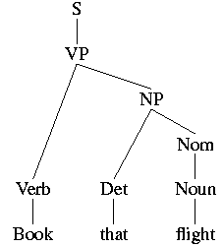
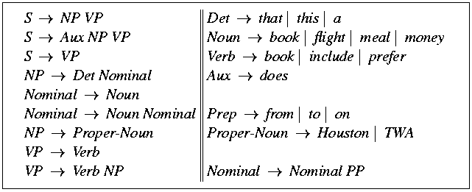
Parsing as Search
The parser can be viewed as searching through the space of all possible parse trees to find the correct parse tree for the sentence.
How can we use the grammar to produce the parse tree?
Parsing with CFG

Slide 31
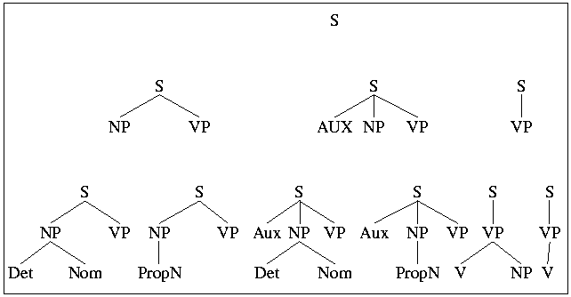
Parsing as Search
Top-down parsing
Parsing with CFG

Slide 32
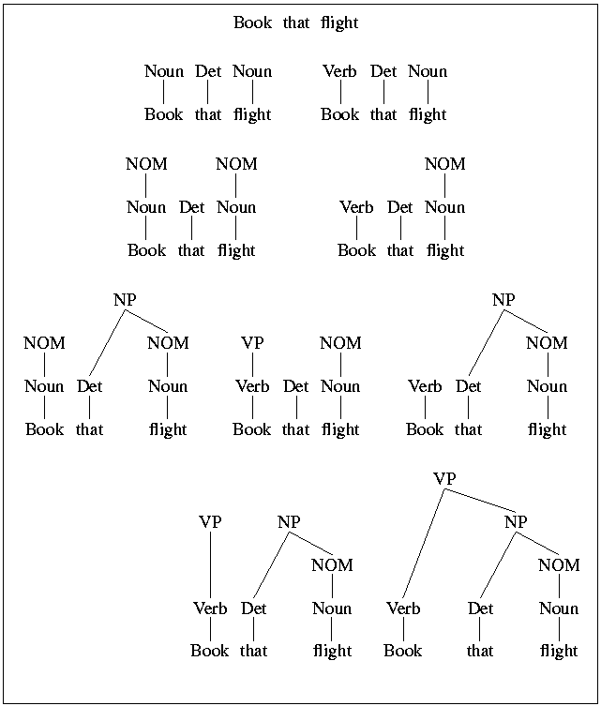
Parsing as Search
Bottom-up parsing
Parsing with CFG

Slide 33
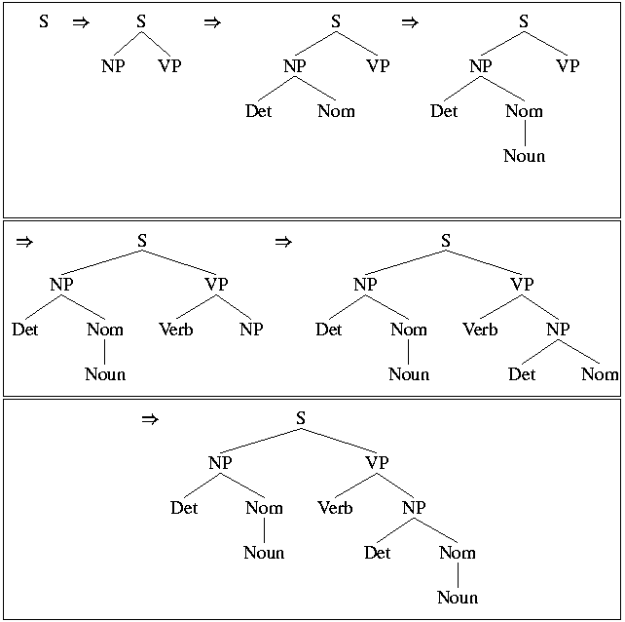
10.2 A Basic Top-Down Parser
Use depth-first strategy
Parsing with CFG

Slide 34
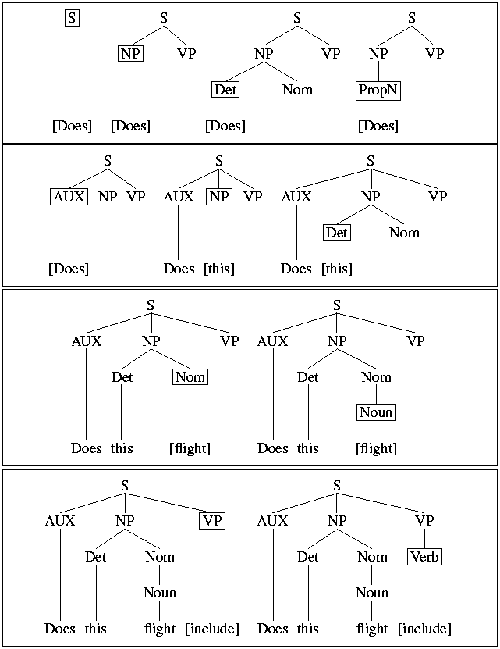
10.2 A Basic Top-Down Parser
A top-down, depth-first, left-to-right derivation
Parsing with CFG

Slide 35
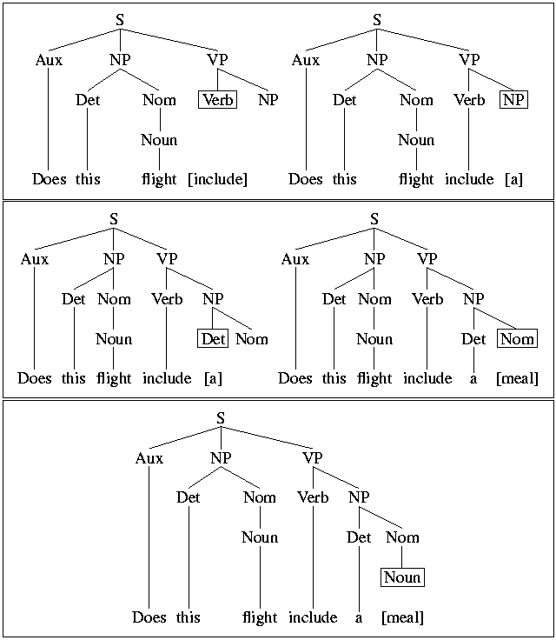
10.2 A Basic Top-Down Parser
Parsing with CFG

Slide 36
10.3 Problems with the Basic Top-Down Parser
Problems with the top-down parser
  Left-recursion
  Ambiguity
  Inefficiency reparsing of subtrees
Parsing with CFG

Slide 37
10.3 Problems with the Basic Top-Down Parser
Ambiguity
Parsers which do not incorporate disambiguators may simply return all the possible parse trees for a given input.
We do not want all possible parses from the robust, highly ambiguous, wide-coverage grammars used in practical applications.
Reason:
  Potentially exponential number of parses that are possible for certain inputs
  Given the ATIS example:
    Show me the meal on Flight UA 386 from San Francisco to Denver.
  The three PP’s at the end of this sentence yield a total of 14 parse trees for this sentence.
Parsing with CFG

Slide 38
Statistical Parsing
Statistical parsing uses a probabilistic model of syntax in order to assign probabilities to each parse tree.
Provides principled approach to resolving syntactic ambiguity.
Allows supervised learning of parsers from tree-banks of parse trees provided by human linguists.
Also allows unsupervised learning of parsers from unannotated text, but the accuracy of such parsers has been limited.

Slide 39
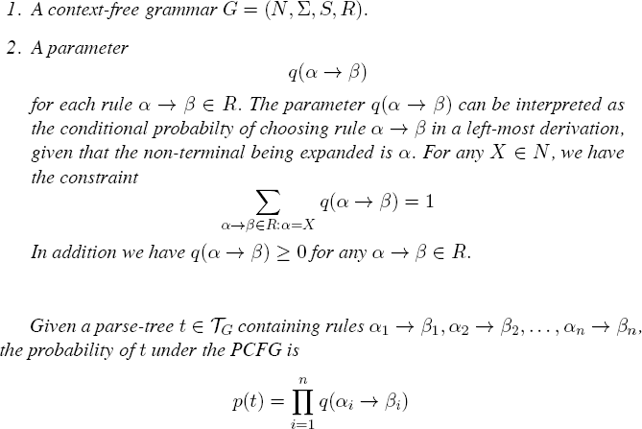
SCFG

Slide 40
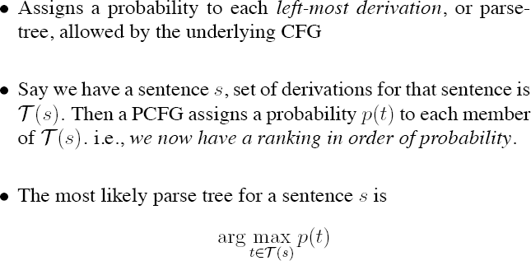
SCFG

Slide 41
Probabilistic Context Free Grammar
(PCFG)
A PCFG is a probabilistic version of a CFG where each production has a probability.
Probabilities of all productions rewriting a given non-terminal must add to 1, defining a distribution for each non-terminal.
String generation is now probabilistic where production probabilities are used to non-deterministically select a production for rewriting a given non-terminal.

Slide 42
Simple PCFG for ATIS English
Grammar
Prob
Lexicon
S → NP VP
S → Aux NP VP
S → VP
NP → Pronoun
NP → Proper-Noun
NP → Det Nominal
Nominal → Noun
Nominal → Nominal Noun
Nominal → Nominal PP
VP → Verb
VP → Verb NP
VP → VP PP
PP → Prep NP
0.8
0.1
0.1
0.2
0.2
0.6
0.3
0.2
0.5
0.2
0.5
0.3
1.0
Det → the | a | that | this
0.6 0.2 0.1 0.1
Noun → book | flight | meal | money
0.1 0.5 0.2 0.2
Verb → book | include | prefer
0.5 0.2 0.3
Pronoun → I | he | she | me
0.5 0.1 0.1 0.3
Proper-Noun → Houston | NWA
0.8 0.2
Aux → does
1.0
Prep → from | to | on | near | through
0.25 0.25 0.1 0.2 0.2
+
1.0
+
1.0
+
1.0
+
1.0

Slide 43
Sentence Probability
Assume productions for each node are chosen independently.
Probability of derivation is the product of the probabilities of its productions.
P(D₁) = 0.1 x 0.5 x 0.5 x 0.6 x 0.6 x
0.5 x 0.3 x 1.0 x 0.2 x 0.2 x
0.5 x 0.8
⁼ 0.0000216
S
D₁
0.1
VP
0.5
Verb NP
0.6
0.5
book
Det Nominal
0.5
0.6
the
Nominal PP
1.0
0.3
Noun
Prep NP
0.2
0.5
0.2
flight
through
Proper-Noun
0.8
Houston

Slide 44
Syntactic Disambiguation
Resolve ambiguity by picking most probable parse tree.
S
D₂
P(D₂) = 0.1 x 0.3 x 0.5 x 0.6 x 0.5 x
0.6 x 0.3 x 1.0 x 0.5 x 0.2 x
0.2 x 0.8
⁼ 0.00001296
0.1
VP
0.3
VP
0.5
Verb NP
0.6
0.5
PP
book
Det Nominal
1.0
0.6
0.3
the
Noun
Prep NP
0.2
0.5
0.2
flight
through
Proper-Noun
0.8
Houston

Slide 45
Sentence Probability
Probability of a sentence is the sum of the probabilities of all of its derivations.
P(“book the flight through Houston”) =
P(D₁) + P(D₂) = 0.0000216 + 0.00001296
= 0.00003456

Slide 46
Three Useful PCFG Tasks
Observation likelihood: To classify and order sentences.
Most likely derivation: To determine the most likely parse tree for a sentence.
Maximum likelihood training: To train a PCFG to fit empirical training data.

Slide 47
Treebanks
a treebank is a parsed textcorpus that annotates syntactic or semantic sentence structure.
English Penn Treebank: Standard corpus for testing syntactic parsing consists of 1.2 M words of text from the Wall Street Journal (WSJ).
Typical to train on about 40,000 parsed sentences and test on an additional standard disjoint test set of 2,416 sentences.
Chinese Penn Treebank: 100K words from the Xinhua news service

Slide 48
Parsing Evaluation Metrics
PARSEVAL metrics measure the fraction of the constituents that match between the computed and human parse trees. If P is the system’s parse tree and T is the human parse tree:
  Recall = (# correct constituents in P) / (# constituents in T)
  Precision = (# correct constituents in P) / (# constituents in P)
Labeled Precision and labeled recall require getting the non-terminal label on the constituent node correct to count as correct.

